Slide 1
Linear and Logistic Regression Sounak Roy Sep’18

Slide 2
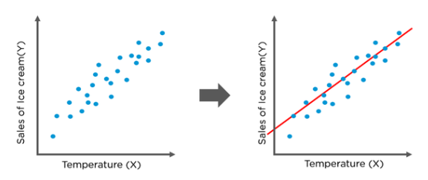
Least Squares Method
Suppose you want to predict the amount of ice cream sales you would make based on the temperature of the day, then you can plot a regression line that passes through all data points.
Least squares is one of the methods to find the best fit line for a dataset using linear regression. The most common application is to create a straight line that minimizes the sum of squares of the errors generated from the differences in the observed value and the value anticipated from the model. Least-squares problems fall into two categories: linear and non linear squares, depending on whether or not the residuals are linear in all unknowns.

Slide 3
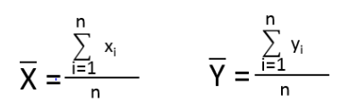
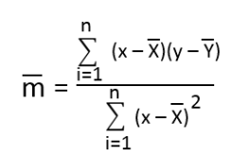

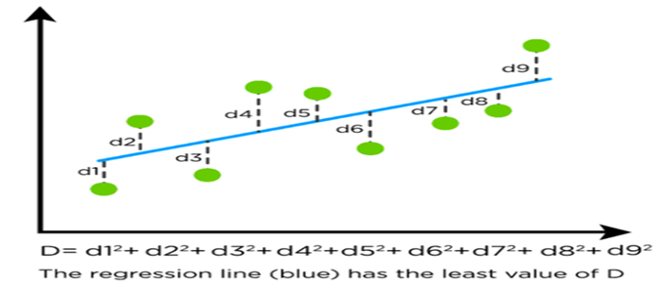
Follow the below steps to find the best fit line for a set of ordered pairs (x1,y1), (x2,y2)….
Step 1: Calculate the mean of x values and the mean of y values
Step 2: Calculate the slope of the best fit line using the following formula
Step 3: Calculate the y-intercept of the line by the below formula:
The best fit line is called the regression line and it has the least square of distance from each data point to the line

Slide 4
Important assumptions in regression analysis
There should be a linear and additive relationship between dependent (response) variable and independent (predictor) variable(s). A linear relationship suggests that a change in response Y due to one unit change in X¹ is constant, regardless of the value of X¹. An additive relationship suggests that the effect of X¹ on Y is independent of other variables.
There should be no correlation between the residual (error) terms. Absence of this phenomenon is known as Autocorrelation.
The independent variables should not be correlated. Absence of this phenomenon is known as multicollinearity.
The error terms must have constant variance. This phenomenon is known as homoskedasticity. The presence of non-constant variance is referred to heteroskedasticity.
The error terms must be normally distributed.

Slide 5
Logistic Regression
Logistic regression is based on Maximum Likelihood (ML) Estimation which says coefficients should be chosen in such a way that it maximizes the Probability of Y given X (likelihood).
With ML, the computer uses different "iterations" in which it tries different solutions until it gets the maximum likelihood estimates.
Fisher Scoring is the most popular iterative method of estimating the regression parameters.
logit(p) = b0 + b1X1 + b2X2 + ------ + bk Xk
where logit(p) = loge(p / (1-p))
p : the probability of the dependent variable equaling a "success" or "event".
Binary logistic regression model assumes binomial distribution of the response with N(number of trials) and p(probability of success).
Logistic regression is in the 'binomial family' of GLMs.
The dependent variable does not need to be normally distributed.

Slide 6
Interpretation of Logistic Regression Estimates
If X increases by one unit, the log-odds of Y increases by k unit, given the other variables in the model are held constant. In logistic regression, the odds ratio is easier to interpret. That is also called Point estimate. It is exponential value of estimate.
For Continuous Predictor
An unit increase in years of experience increases the odds of getting a job by
multiplicative factor of 4.27, given the other variables in the model are held
constant.
In other words, the odds of getting a job are increased by 327% (4.27-1)*100
for an unit increase in years of experience.
For Binary Predictor The odds of a person having years of experience getting a job are 4.27 times greater than the odds of a person having no experience.
Note : To calculate 5 unit increase, 4.27 ^ 5 (instead of multiplication).

Slide 7
Assumptions of Logistic Regression
The logit transformation of the outcome variable has a linear relationship with the predictor variables.
The one way to check the assumption is to categorize the independent variables. Transform the numeric variables to 10/20 groups and then check whether they have linear or monotonic relationship.
No multicollinearity problem. No high correlationship between predictors.
No influential observations (Outliers).
Large Sample Size - It requires atleast 10 events per independent variable.

Slide 8
Odd’s ratio
In logistic regression, odds ratios compare the odds of each level of a categorical response variable. The ratios quantify how each predictor affects the probabilities of each response level.
For example, suppose that you want to determine whether age and gender affect whether a customer chooses a electric car. You create a logistic regression model with the following variables
Suppose the logistic regression procedure declares both predictors to be significant. If GENDER has an odds ratio of 2.0, the odds of a woman buying a electric car are twice the odds of a man. If AGE has an odds ratio of 1.05, then the odds that a customer buys a hybrid car increase by 5% for each additional year of age
Odd Ratio (exp of estimate) less than 1 ==> Negative relationship (It means negative coefficient value of estimate coefficients)

Slide 9
Appendix
Linear Regression
Logistic Regression

Slide 10
Thank You !!

